Slide 1

Let’s reform
INSTACART
By:
Srihari Nair

Slide 2
TABLE OF CONTENTS
01
ABOUT INSTACART
02
PRODUCT IMPROVEMENT
03
THE NEW ADDITIONS
04
USER
TESTING

Slide 3
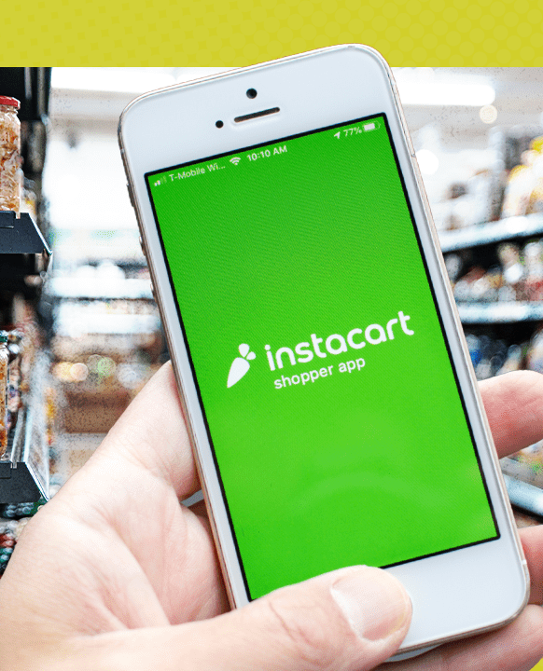
01
ABOUT INSTACART

Slide 4

WHAT IS INSTACART
Instacart is a leading grocery delivery and pick-up service operating in North America.
Instacart connects customers with personal shoppers who pick, pack, and deliver groceries from local stores, allowing users to shop from the comfort of their homes.

Slide 5
COMPETITIVE LANDSCAPE
Instacart is founded, introducing a crowdsourced model for same-day delivery.
Uber Eats and DoorDash enter the grocery delivery market, increasing competition.
Instacart launches “Instacart Ads” and “Instacart Platform” to stay competitive against Uber Eats and DoorDash.
2012
2015
2019
2020
2022
Instacart expands rapidly, becoming a major market player.
COVID-19 boosts demand; Instacart, Uber Eats, and DoorDash experience significant growth.

Slide 6
INSTACART’S STRATEGY
Instacart Express
Pharmacy Delivery
Grocery Delivery
Curbside Pickup
A subscription service offering free delivery on orders over a certain amount and reduced service fees.
Delivery of prescription medications from partnered pharmacies.
Customers can order groceries online and have them delivered to their doorstep within hours.
Customers can shop online and pick up their orders at a designated store location.

Slide 7
THE BUSINESS MODEL
Two-Sided Marketplace | Customers, Retail Partners
Revenue Streams | Delivery Fee, Membership, Service Fee, Advertising, Retailer Commission
Value Proposition | Convenience, Wide Selection, Flexibility
Customer Segments | Individual Consumers, Businesses

Slide 8
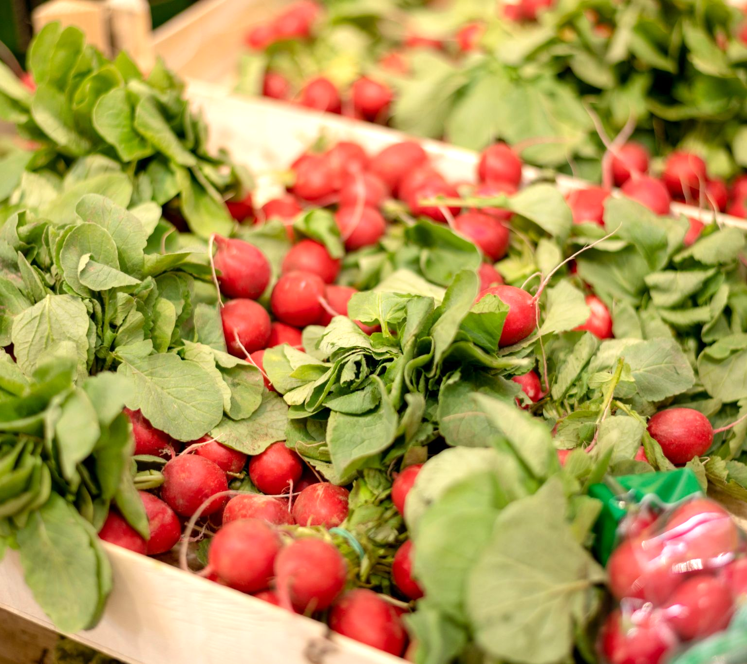
02
PRODUCT IMPROVEMENT

Slide 9
OUR NEW FEATURE IDEAS
Meal Kits
Personalization
Sustainability
Quirky Notifications
Grocery Budget Tracker
Nutritional Summary
Convenient pre-portioned gourmet to-cook meal solutions
Customize the app experience based on your preferences
A score to promote users for better shopping habits
Playful, engaging reminder alerts notifications.
Smart, efficient spending management tool
Comprehensive, detailed health information insights for each order

Slide 10

FEATURES WE DEVELOPED
Meal Kits
Benefits
To compete with Uber Eats and DoorDash, we're launching meal kits with pre-measured ingredients and simple recipes for convenient, high-quality home cooking.
- Customize your order size.
- Swap Ingredients to your taste.
- Ingredients sourced from trusted suppliers.
- Eco-Friendly Packaging
This feature boosts customer satisfaction and loyalty with convenient, customizable, high-quality meal solutions.
If meal kits lead to a 10% increase in orders with an average value of $200 and 1 million active users, this could add $20 million in annual revenue.

Slide 11
FEATURES WE DEVELOPED
Personalization
Benefits
Personalize your Instacart experience by adding preferences to declutter your app screen. Choose from:
- Who you shop for
- What you shop for
- How often you shop
Enhance your shopping with a streamlined, tailored app experience.
Streamlining the app interface based on user preferences boosts efficiency and user satisfaction, leading to higher engagement and repeat purchases.
A 5% increase in customer retention, with each of Instacart's 1 million active users spending $500 annually, could generate an additional $25 million in annual revenue.

Slide 12

FEATURES WE DEVELOPED
Sustainability
Benefits
Elevating eco-consciousness decision making for Instacart users
- Detailed sustainability ratings for ingredients
- Personalized sustainability scores for customers
- Promotes eco-friendly products from brands like Whole Foods
Providing sustainability ratings and personalized scores encourages eco-friendly shopping, attracting environmentally conscious consumers and boosting brand reputation.
If 20% of 1 million users increase their average spend by $50 annually, this could add $10 million in annual revenue.

Slide 13

FEATURES WE DEVELOPED
Quirky Notifications
Benefits
Based on our experience with Zomato, a food delivery service in India, we've implemented standout notifications. These aren't your boring old alerts. Our notifications resonate with:
- Holidays
- Festivals
- Sporting Events and much more
Engaging, contextually relevant notifications boost customer interaction and retention, driving higher sales.
If notifications increase order frequency by 15% among 50% of users, each placing 10 orders per year at $20 per order, this could add $15 million in annual revenue.

Slide 14
03
THE NEW ADDITIONS

Slide 15
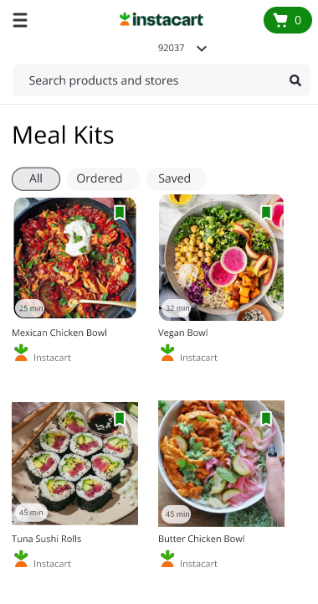
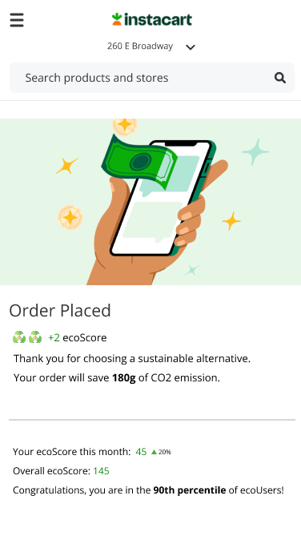
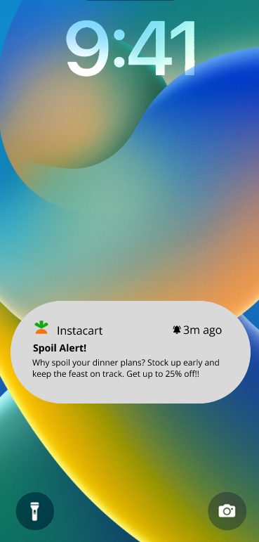
FEATURE MOCKUPS
Click here to view the prototype
Notes:
On this page, we introduce the eco-score feature, which aims to promote sustainable shopping by informing users about the environmental impact of their orders. The eco-score is calculated based on five key factors: Production, Processing, Transportation, Refrigeration, and Packaging.
After placing an order, users see the eco-score summary:
The 'Order Placed' section thanks the user for choosing a sustainable alternative and shows the CO2 emissions saved by their order.
The 'Your ecoScore this month' section tracks the user's monthly eco-score progress.
The 'Overall ecoScore' displays the cumulative eco-score and congratulates users for being in the 90th percentile of eco-users.
This feature encourages users to make more environmentally friendly choices by providing clear feedback on their shopping habits

Slide 16
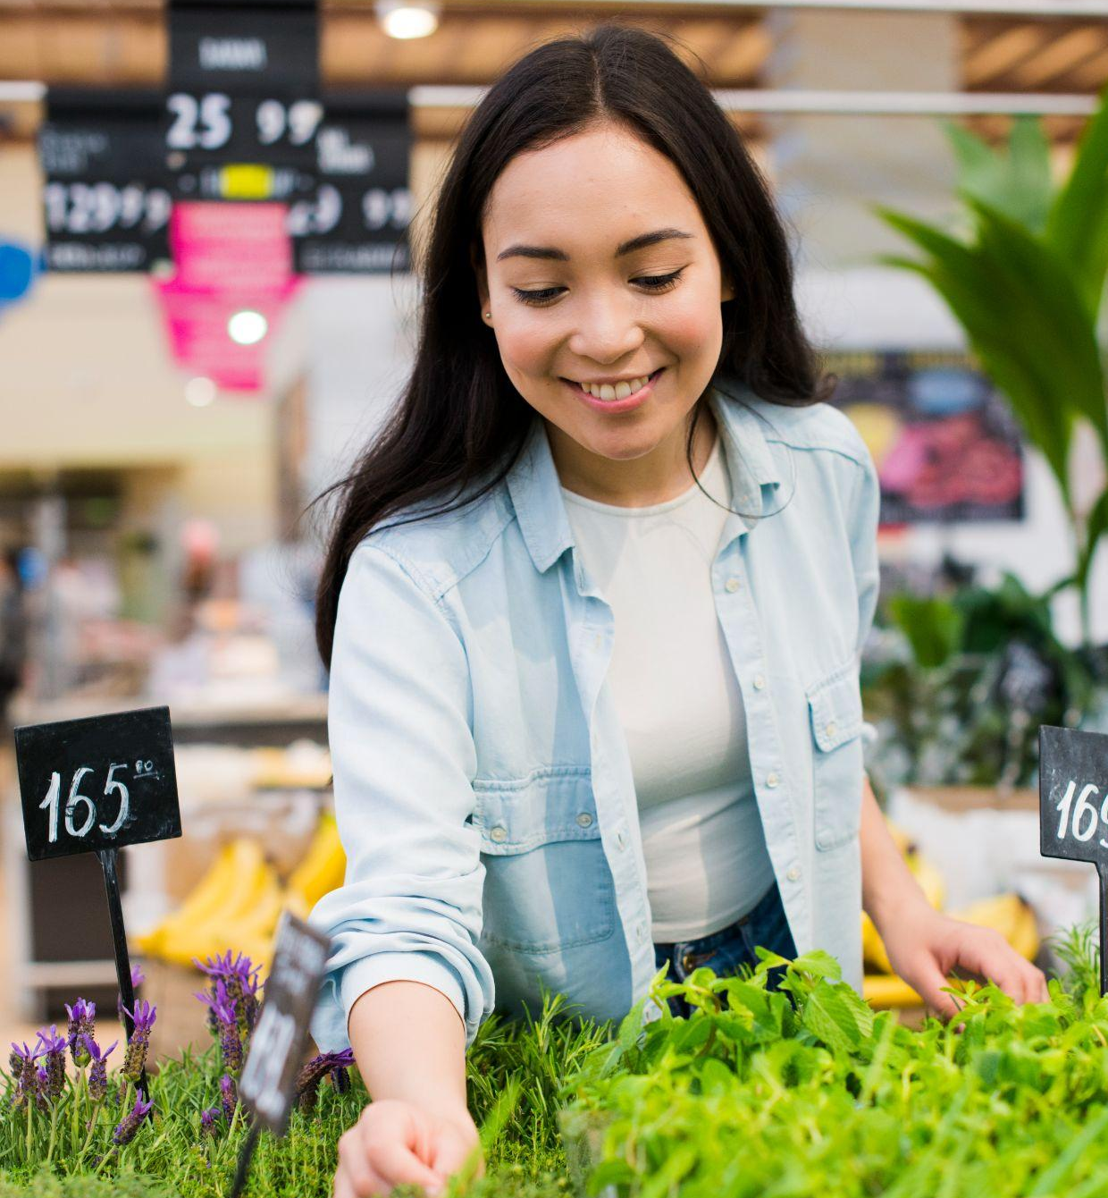
04
USER TESTING

Slide 17
TESTING OVERVIEW
Participant Demographics
Age between 20 to 40
Gender - Any
Household income between $80k to $150k+
Employed - Full time
Country - United States
Devices - Mac, Windows
Screening Questions
Have you ever used Instacart? (Yes: Accept)

Slide 18
TEST PLAN
Scenario
Imagine you are a user on Instacart trying to purchase a meal kit. This is a prototype with an improved Instacart UI a separate feature to purchase meal kits.
Task
Users will have to sign up using the instructions provided and then navigate through the application to purchase a meal kit. Additionally, users will be able to review the notifications as well.

Slide 19
VERBAL RESPONSE QUESTIONS
We found Instacart's original homepage very cluttered. It had stores which were very random. Our updated homepage presents you with stores based on your personal preferences. Does this make it easier to navigate/use?
How was the experience of ordering a meal kit, was it easy to navigate, intuitive, would you make any changes to the same?
We have added a sustainability feature, called the ecoScore. It basically tells the customer how eco-conscious their order is. This score rates your order on a scale of 3, telling you the CO2 emissions you have saved every order. Will this influence your decision of buying more sustainable products?
Does having a sustainability score make you choose Instacart, over competitors not having this feature?
Tell us what do you think about the notifications? Do you think having these creative and fun notifications will impact your decision of opening the app?

Slide 20
USER FEEDBACK
Personalized Homepage
Great feature! More specific stores based on customer preferences
Limiting the no. of stores on the homepage to make it more streamlined
Increased usability and customer satisfaction, higher engagement, and repeat purchases.
Meal Kits
Wonderful idea, pre filling carts instead of picking each item.
Prefer ingredient substitutions in the cart. Recipe booklet
Customization, simplicity, and transparency are crucial for user satisfaction.
Enhanced customization, user-friendly experience, improved transparency, will lead to higher engagement and sales.

Slide 21
USER FEEDBACK
Sustainability and ecoScore
Eco score is not central to grocery shopping decisions, considered vague.
Clear communication and detailed information about sustainability scores are necessary
Enhanced communication, trust, and potential attraction of eco-conscious consumers.
Quirky Notifications
Good idea but risk of fading into the background due to overexposure.
Notifications should focus on relevant deals and promotions, differentiation and relevance are key.
Targeted notifications increase app engagement, satisfaction, and sales.

Slide 22
TEST SUMMARY
Personalized Homepage
Meal Kits
Sustainability and ecoScore
Quirky Notifications
Value
4/5
Value
5/5
Usability
5/5
Usability
3/5
Value
3/5
Value
3/5
Usability
2/5
Usability
3/5
*Based on the user testing results
Notes:
Value = the actual value the feature provides the users
Usability = the user experience (how easy the user find the feature to use)
Let’s write that based on the user testing results and the survey we did with other users personally?
Im skipping slide 23

Slide 23
05
CONCLUSION

Slide 24
FINAL RECOMMENDATIONS
Add the Meal Kits feature to Instacart
There is an overwhelmingly positive response from user testing for the feature, as well as an excellent business case.
The Total Addressable Market for the meal kit delivery service in the US is $8.7 billion and growing at 15% CAGR. A significant portion of this market can be easily tapped into by Instacart through its existing user base.
Refine and implement the ecoScore feature
ecoScore feature helps attract eco-conscious customers as well as improve brand reputation.
As per the user feedback received, the score calculations should be transparent to build more trust in the system amongst the users.
Implement personalized homepage and notifications
Personalized homepage has received positive feedback unanimously from our test users and implementing it will lead to better user experience.
Quirky notifications help nudge the user and result in more orders.

Slide 25
THANKS! Do you have any questions?

